Slide 1
University of Toronto BAJA SAE Racing Team Sponsorship Package 2014-2015

Slide 2
Letter From the President
Greetings,
Since its conception in early 2013, the University of Toronto’s Baja SAE team has set a reputation for building a simple and beautifully designed race buggy. The passion for engineering is one that is shared amongst the founders and new team leaders alike.
The UofT Baja SAE team aims to reflect the world class reputation of the University of Toronto’s engineering program with team management, design, and performance. We are well on our way to achieving such a status with the performance at our first and latest competition in Kansas. We have set a solid footprint—or rather tire print—in the world of the Baja SAE Collegiate Design Series.
Contributions from companies like yours enable a student-run organization like ours to exist and educate students beyond the classroom. We wish to thank you for your consideration.
Yours sincerely,
Daniel Garza

Slide 3
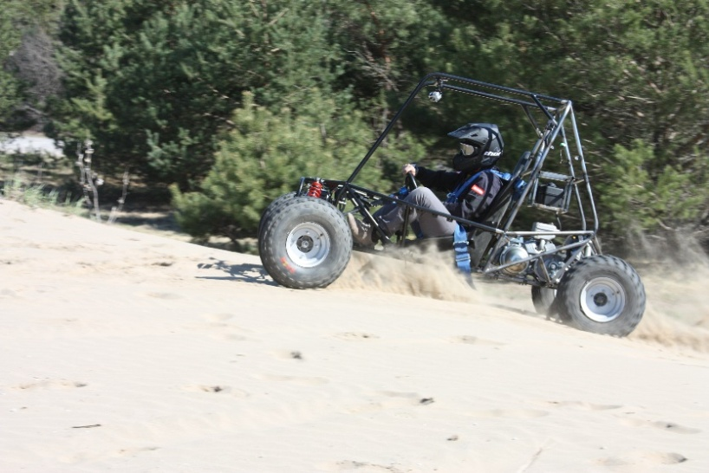
About Baja
Baja SAE is about testing the limits of a student-built all-terrain vehicle in a competitive and exciting environment
How
The Society of Automotive Engineers (SAE) holds three international competitions each year with teams
from around the world
Benefits
Engineering students learn how to tackle a challenging project that involves planning, designing, building, and promoting as a team.
Notes:
We build one car a year.

Slide 4
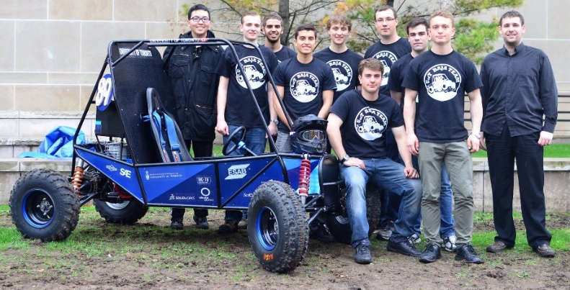
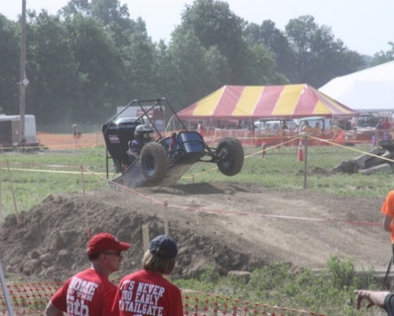
Our Mission
To inspire young engineers to develop hands-on, problem solving, and teamwork skills through the building of a competitive off-road racer.
Past Results
Kansas 2014
First In Ontario
48th place endurance
53rd place overall out of 119 teams
55th place acceleration
55th place overall static events

Slide 5
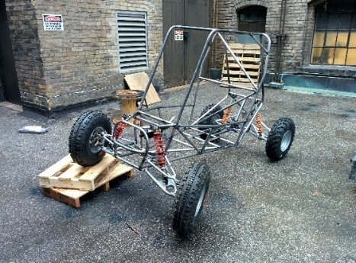
The Car
Frame
1025 mild steel
Inspired by classic race cars
Suspension & Steering
Independent double wishbone front and rear
Powertrain
300cc Briggs & Stratton engine
CVT transmission
Notes:
Make the last picture big and mention sponsorship opportunity on the car

Slide 6
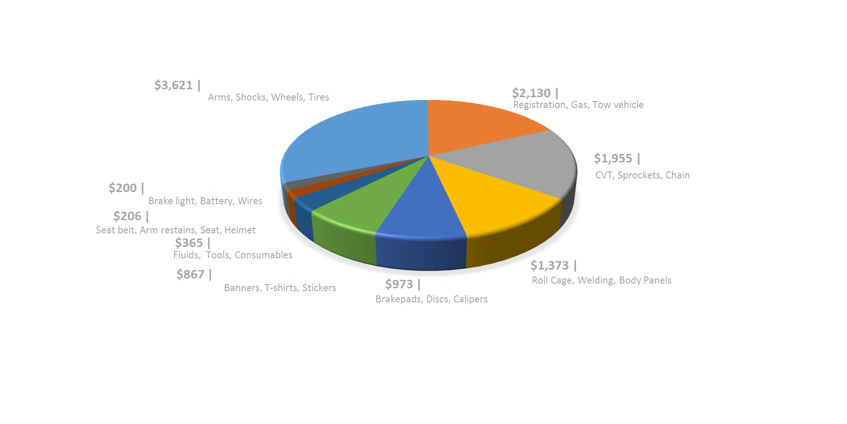
2013 - 2014 Budget
Total expenses: $12,120

Slide 7
Key Events for 2014-2015
2014
Competition
2014 SAE Night
Begin Design
Finalize Frame Design
Recruitment and Fabrication
ATV & Snowmobile Show
Finish Frame Fabrication
Components Fabrication
Motorcycle Supershow
Complete
Fabrication
Vehicle Testing
2015 Competition
Driver Training
Jun
Aug
Oct
Dec
Feb
Apr
Jul
Sep
Nov
Jan
Mar
Notes:
Can we do an contest in UofT for all the Canadian universities?
Update progress on Twitter, FB, etc. for publicity

Slide 8
Why Work with Us?
Educational Experience
At UofT Baja, we are promising engineering students with the most authentic Hands-on Learning Experience. By working with us, you are not only granting students the opportunity to learn, but Inspiring the next generation of engineers.
Fast Growing
As the new comer of Baja SAE Completion, we ranked 1st in Ontario. Overall, we finished 53rd out of 119 teams, surpassing other well established teams. With our experience and your support, we are aiming to compete against the Top 20 Teams.
Publicity
Our team plans on attending two world-class trade shows over the course of the 2014-2015 season:
Hosting events for the student body: frosh week, club fair events.
Toronto International ATV and Snowmobile Show.
North American International Motorcycle Supershow.
Over 10,000 students and 50,000 people are expected to attend these events.
UofT Affiliation
We would be honored to have your company
carry on the World-class Reputation of
the University of Toronto.
Notes:
Refine the design
Exposure for students!!! This is what the company care about

Slide 9
Sponsorship Opportunities
Sponsorship Opportunities
Level of Support | BRONZE | SILVER | GOLD | PLATINUM | PARTNER
 | $250 + | $500 + | $1000 + | $1500 + | $3000 +
Company Logo on UofT Baja Website and Social Media | ü | ü | ü | ü | ü
Company Logo on Race Vehicle |  | S | M | L | XL
Annual UofT Baja Sponsors Appreciation Letter |  | ü | ü | ü | ü
Distribution of Company's Promotional Souvenirs |  | ü | ü | ü | ü
Company Logo on Promotional Video |  |  | S | M | L
Complementary UofT Baja Team T-shirts |  |  | ü | ü | ü
Company Logo on Team Clothing |  |  |  | M | L
UofT Baja On-campus Workshop Tour |  |  |  | ü | ü
Company Logo on Public Event Banners |  |  |  | ü | ü
Complementary Framed UofT Baja Team Photo |  |  |  | ü | ü
Company Logo on Posters on UofT Campus |  |  |  |  | ü
Company Logo on Team Trailer |  |  |  |  | ü
Complementary UofT Baja Promotional Souvenirs |  |  |  |  | ü
Platinum | Over $2999
Recognition on team trailer, and all other benefits listed below.
Gold | Over $1499
Recognition on team banner, team plaque, photo opportunity with the race vehicle, and all other
benefits listed below.
Silver | Over $499
Recognition on race vehicle, info session, framed photograph, and all other benefits listed below.
Bronze | Up to $499
Invitation to our annual Dinner with Baja (personal networking with team), recognition on website,
t-shirt, and team picture.
In addition to monetary and material donations, we will gladly accept:
• Services (machining, welding, other assistance)
• Transportation assistance
• Office supplies
• Shop supplies & tools
(Copied from UCLA)
Additionally:
We are open to discuss naming rights.
We would be glad to accept parts, tools, services, transportation, and office supplies .
We are open to discuss other sponsorship
opportunities.
Notes:
Add:
Exclusive name for this year’s car
Hand-made!
We’ll give you the car after all the race
Name/Car Ownership/Colour/Advertisement
$20,000
Name for the club for a year
$20,000

Slide 10
Current Sponsors
Notes:
What can our sponsors get out of supporting us?

Slide 11
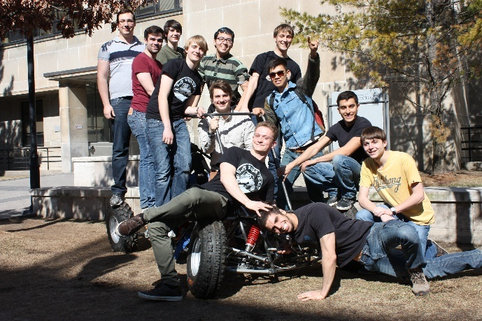
Contact Information
Address
10 Kings College Road
Suite B540 M5S 3G4, Toronto, Ontario
Website
baja.skule.ca
Email
bajateam@utoronto.ca
facebook.com/UofTBaja
@UofTBAJATeam
Phone
+1 (647) 710-7635
ca.linkedin.com/in/uoftbaja

